Slide 1
PROJECT MANAGEMENT SYSTEM

Slide 2
1.
STAGES OF REALIZATION

Slide 3



1ST STAGE - PLANNING
2ND STAGE - REALIZATION
3RD STAGE - PRESENTATION

Slide 4






LANGUAGES AND TOOLS

Slide 5
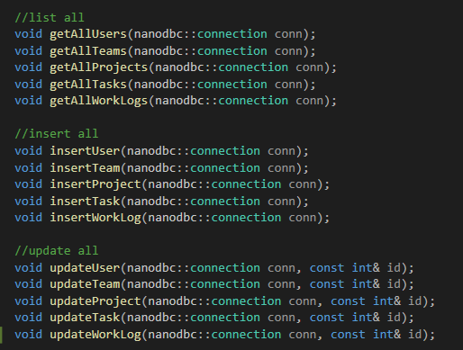
THE FUNCTIONS AND MORE ABOUT THE PROJECT

Slide 6
THANK YOU FOR YOUR ATTENTION!

Slide 7
ANY QUESTIONS?

